Slide 1
Smart Credit Underwriter Democratizing Access to Credit
LoanLex Broadridge - AWS
PRESENTER:
Saitharun, Augustine, Max Winter, Abhinav Guptha, Aviad Stein
DATE:
7th Feb

Slide 2
Problem Statement
Solution
Tech Architecture
Industry Impact
Demo
Future Scope
AGENDA

Slide 3




Slide 4
Problem Statement
Current Underwriting Processes are Slow and Inefficient
Bias and Inconsistency:
Limited Data Utilization
Static Credit Policies
Manual reviews lead to long processing times, delaying loan approvals and frustrating applicants.
Human judgment can be subjective, leading to biased lending practices and inconsistent evaluations.
Traditional methods often fail to leverage the full potential of available data, resulting in inaccurate risk assessments.
Adapting to changing market conditions and risk appetites is challenging with rigid, manually updated policies.
Inefficient Credit Underwriting Process

Slide 5

An intelligent system that automates and enhances credit risk assessment using cutting-edge AI
Dynamic Credit Policy Integration
AI-Powered Evaluation
Real-time Creditworthiness Rating
Explainable AI
Pre Approval with Automated Decisioning
Seamlessly integrates with institutional credit policies, automatically adapting to changes in regulations and risk appetite.
Employs advanced machine learning algorithms to analyze applicant data, including financial history, demographics, and alternative data sources.
Provides an instant creditworthiness score (1-5 rating) based on the current credit policy, enabling quick and informed decisions.
Offers transparent insights into the factors influencing the creditworthiness rating, fostering trust and understanding.
Streamlines the loan approval process, reducing manual intervention and accelerating loan disbursal.

Slide 6
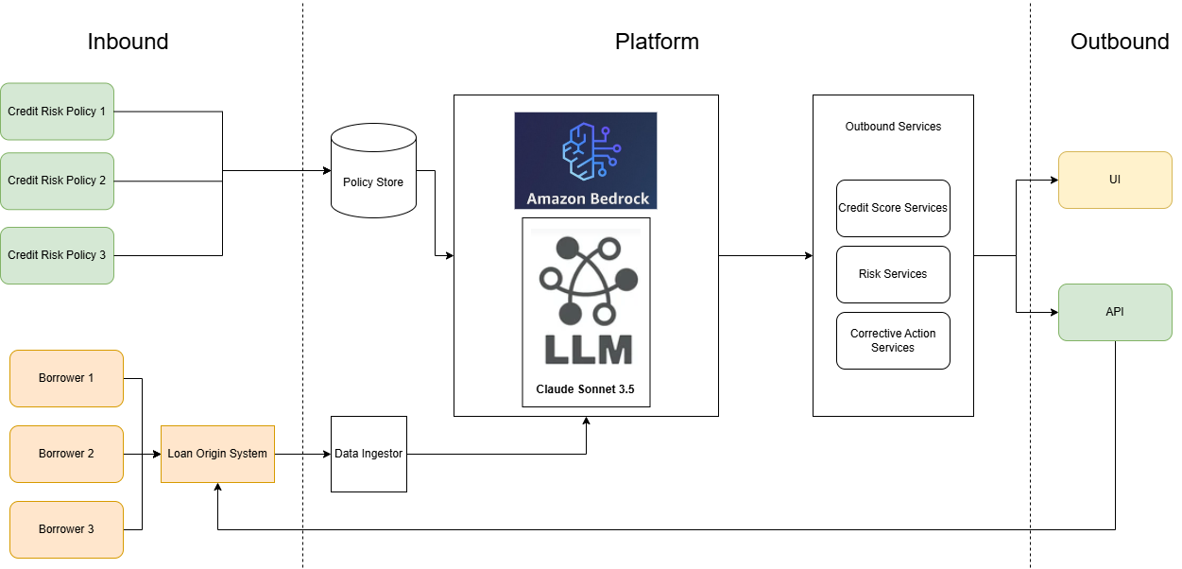
Technical Implementation

Slide 7
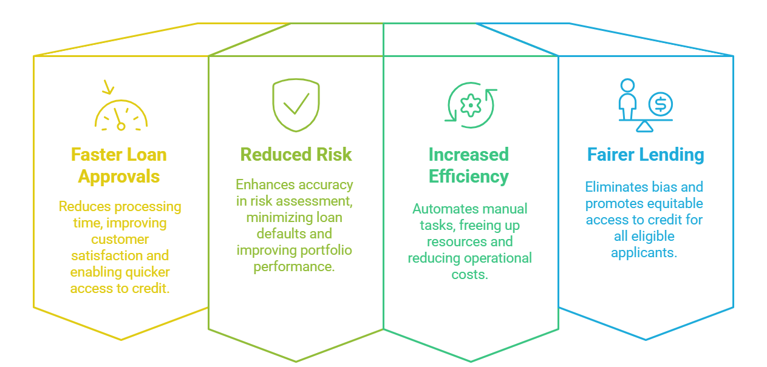
Industry Impact, Collaboration and Production Viability
Industry Impact

Slide 8
Demo
Early Product Walkthrough

Slide 9
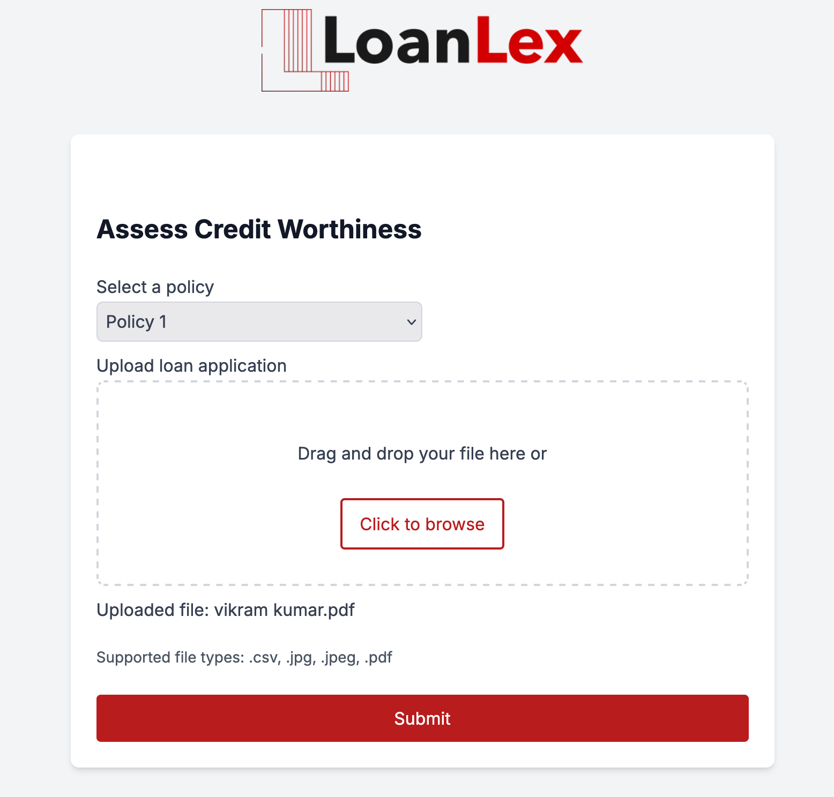

Slide 10
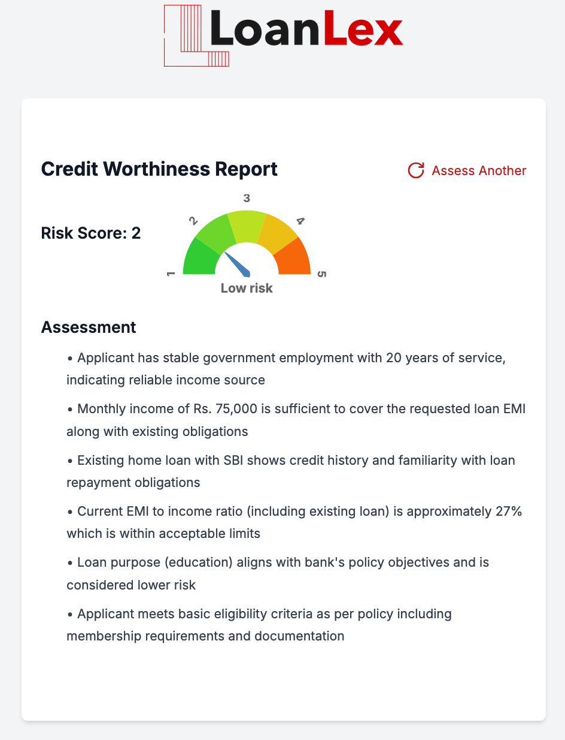
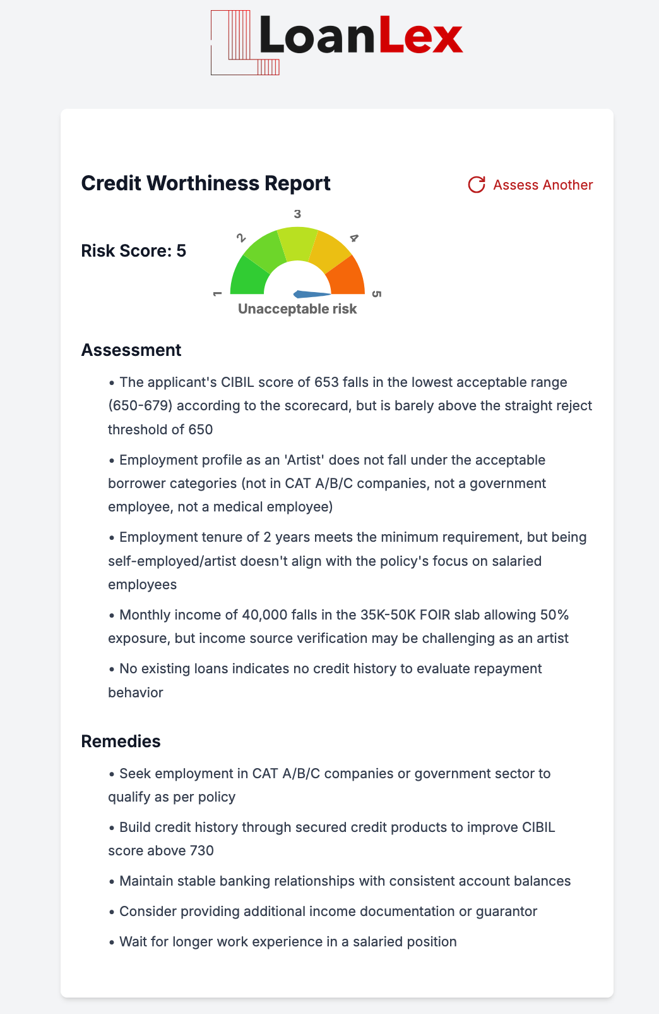

Slide 11
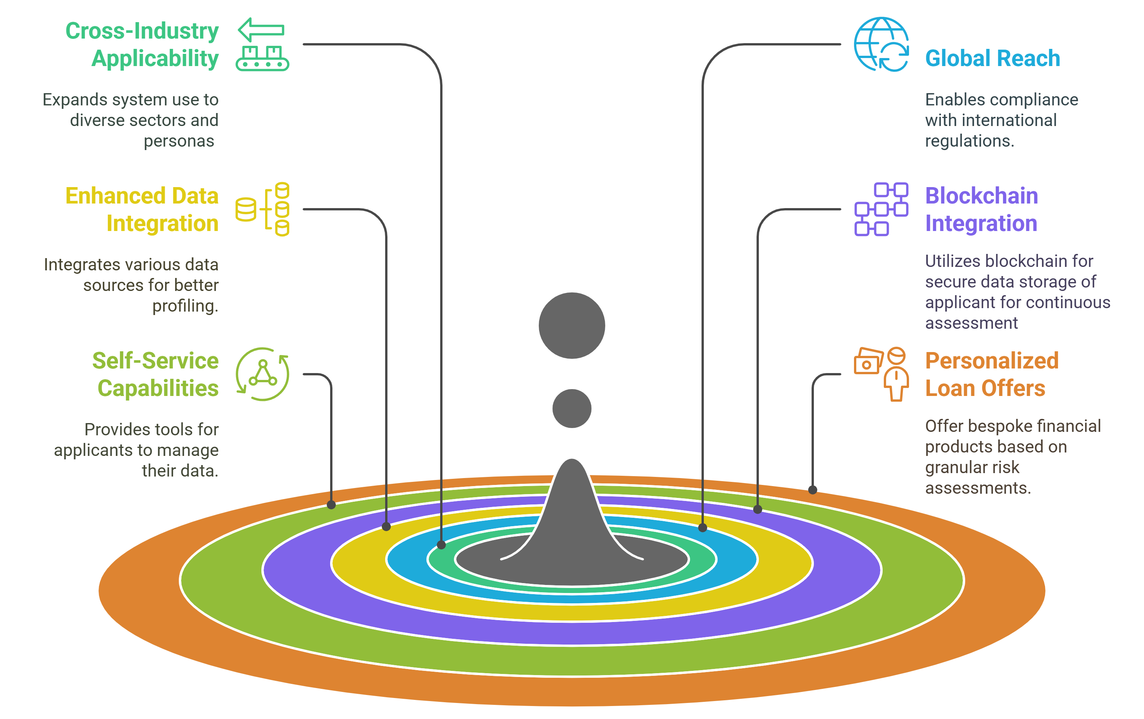
Future Scope

Slide 12
Appendix

